Slide 1
STAC WARS 2026
Project Aegis
PS4 Pitch Deck Submission

Slide 2
THE FIRST INTERPLANETARY GAS STATION
Asteroid Mining Concept
Swarm Architecture & Optical Mining

Slide 3

THE PROBLEM
The Gravity Bottleneck
Space exploration is severely limited by Earth's gravity well.
Lifting heavy rocket propellant into orbit costs thousands per kilogram.
To explore deeper, we absolutely need fuel that is already in space.

Slide 4
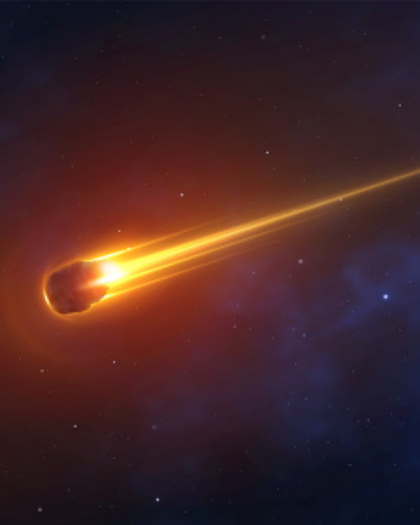
THE SOLUTION
Near-Earth Optical Mining
Targeting ice-rich Near-Earth Asteroids (NEAs).
Focusing intense sunlight to bake water out, eliminating heavy mechanical drills.
Deploying cheap, automated micro-satellites instead of massive monolithic ships.

Slide 5



TECHNOLOGY
Swarm Architecture
Extraction
Capture
Transport
Inflatable solar reflectors concentrate heat to fracture surface rock and release vapor.
Specialized cold traps instantly freeze the escaping vapor into harvestable ice blocks.
Automated drone ships carry the secured ice payloads back to stable Earth orbits.

Slide 6

BUSINESS MODEL
Selling in Orbit
Bringing asteroid water back to Earth ruins the profit margin entirely.
We refine the ice into pure Hydrogen and Oxygen propellant directly in orbit.
We sell to LEO satellite companies at a massive discount compared to Earth-launches.

Slide 7

Fueling the Next Frontier
Project Aegis isn't just mining rock; it's building the foundational infrastructure for humanity's expansion into the solar system.
THANK YOU. READY FOR Q&A.

Slide 8




ATTRIBUTION
Image Sources
Source: www.istockphoto.com
https://media.istockphoto.com/id/2148304895/photo/rocket-launch-into-the-blue-starry-sky-space-wallpaper.jpg?s=612x612&w=0&k=20&c=qRidRXDnJFjPaLhNVaUR7mEwcZ6ZaDCQYrWAfajQH7Y=
Source: www.istockphoto.com
https://media.istockphoto.com/id/1222035078/vector/realistic-comet-meteorite-an-asteroid-in-motion-burns-against-the-background-of-outer-space.jpg?s=170667a&w=0&k=20&c=oafDNGzitDtb543n53fjjKCwYaLePFZTEXIWng-g9Tc=
Source: creator.nightcafe.studio
[link removed]

